Slide 1

Working With Textures
Mohammad Luthfi Rahmatullah
Krisna Badru Wijaya
Paksi Ario Pamungkas
Arino Jenynof
Nadhif Haikal Farhansyah
05111740000038
05111740000048
05111740000076
05111740000096
05111740000137

Slide 2
What We Will Learn :
Memuat tekstur dan menerapkannya
Using bump and normal maps to apply depth and detail to a mesh
Creating fake shadows using a light map
Adding detailed reflection to a material using an environment map
Using a specular map to set the shininess of specific parts of a mesh
Fine-tuning and customizing the UV mapping of a mesh
Using the HTML5 canvas and video element as input for a texture

Slide 3
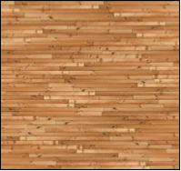
Memuat tekstur dan menerapkannya
The most basic usage of a texture is when it's set as a map on a material. When you use this material to create a mesh, the mesh will be colored based on the supplied texture.
You can use pretty much any image you'd like as a texture. The best results, however, are when you use a square texture whose dimensions are a power of 2. So dimensions such as 256 x 256, 512 x 512, 1024 x 1024, and so on work the best
Contoh Square Texture:

Slide 4
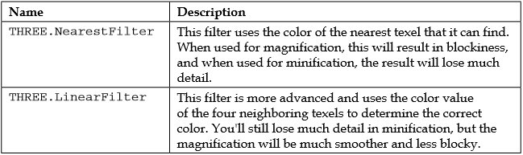
You can specify how the texture is magnified by setting the magFilter property and how it is minified with the minFilter property.

Slide 5
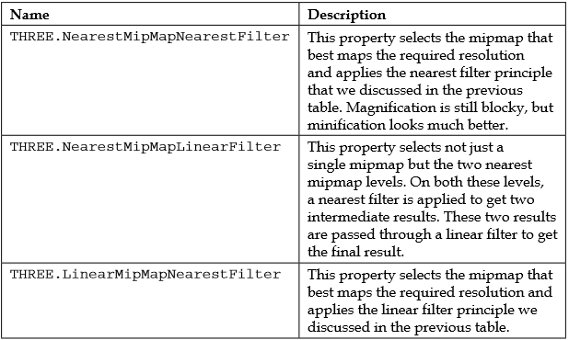
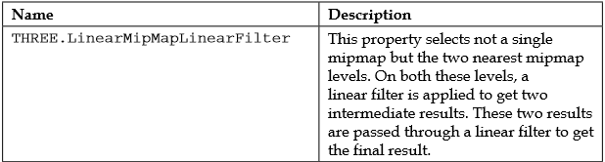
Mipmap is a set of texture images, each half the size of the previous one. These are created when you load the texture and allow much smoother filtering. So, when you've got a square texture (as a power of 2), you can use a couple of additional approaches for better filtering.

Slide 6
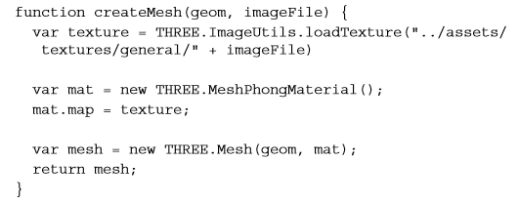
How To Lewd Load A Texture

Slide 7
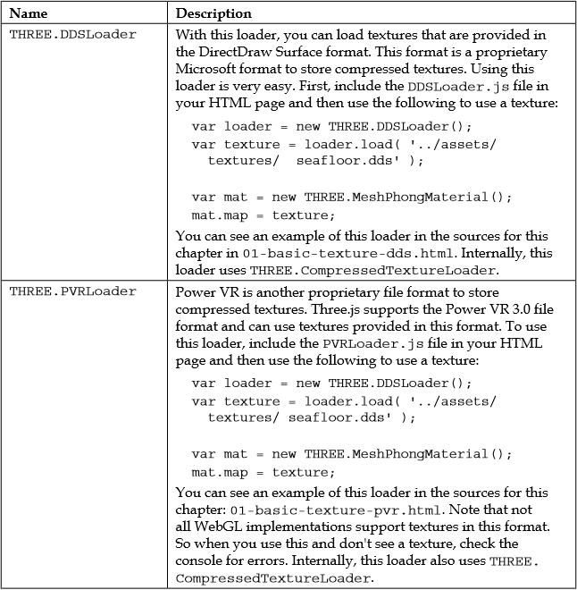
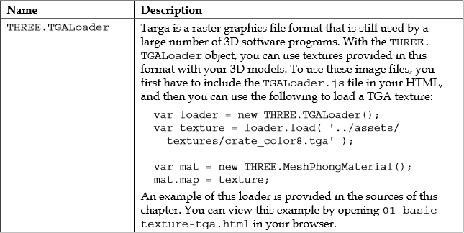
How To Lewd Load A Texture Continuation

Slide 8
Using bump and normal maps to apply depth and detail to a mesh
Using a bump map to create wrinkles
A bump map is used to add more depth to a material.
The intensity of the pixel defines the height of the bump. A bump map only contains the relative height of a pixel. It doesn't say anything about the direction of the slope. So the level of detail and perception of depth that you can reach with a bump map is limited.

Slide 9
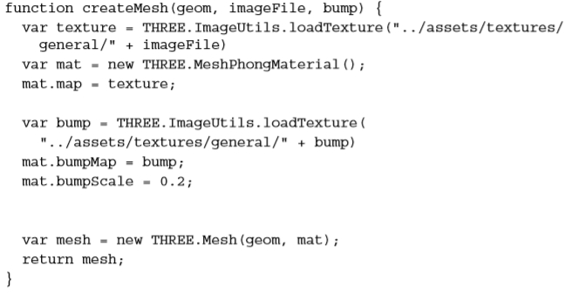
How To Do That ?

Slide 10
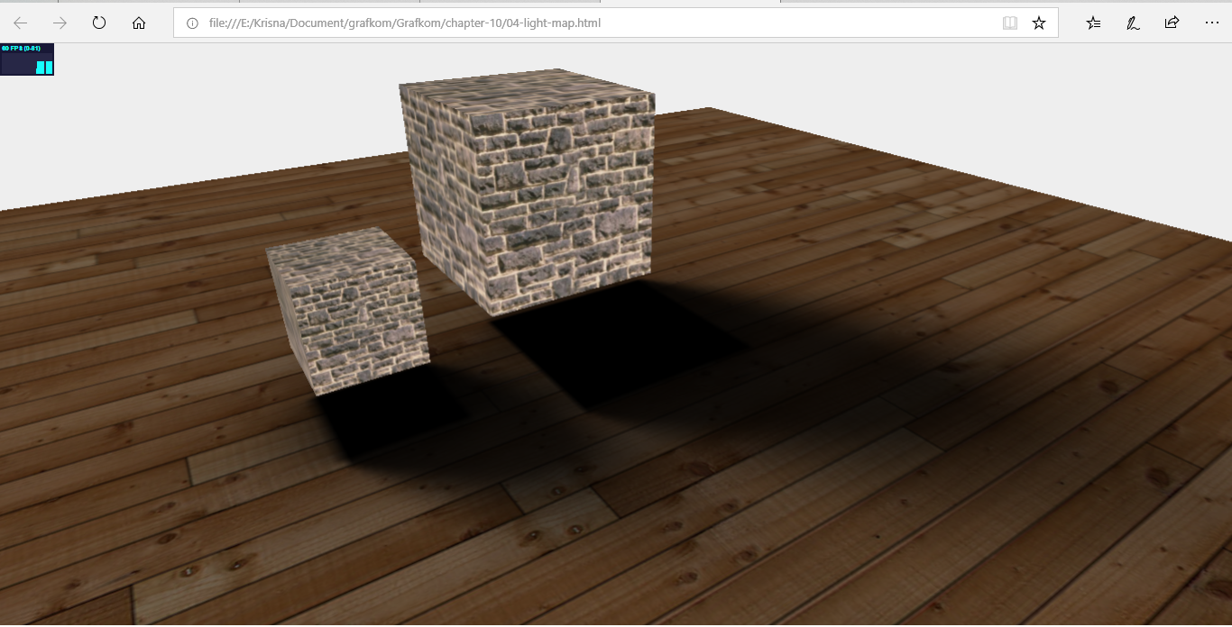
Creating fake shadows using a light map
A light map is a pre-rendered shadow (also called a prebaked shadow) that you can use to create the illusion of a real shadow.

Slide 11
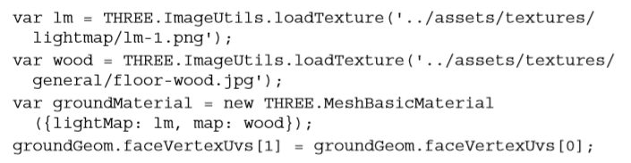
How To Do That ?

Slide 12
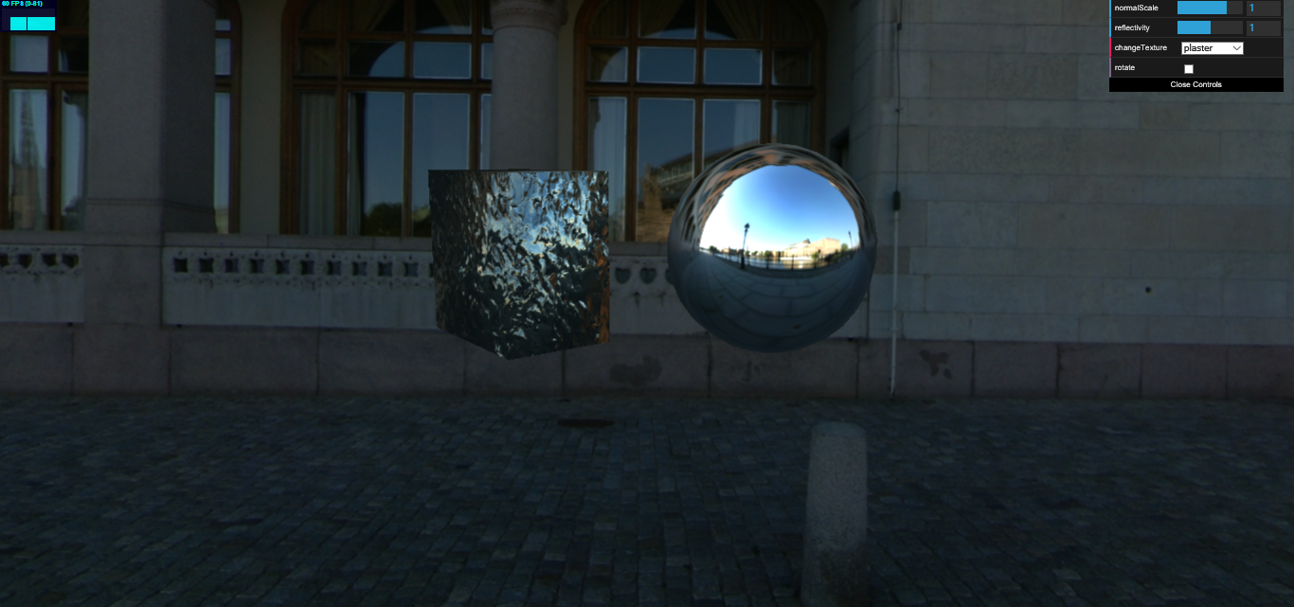
Adding detailed reflection to a material using an environment map (static)
You can do this by creating a texture of the environment the object is in and apply this to the specific object

Slide 13

How To Do That????

Slide 14
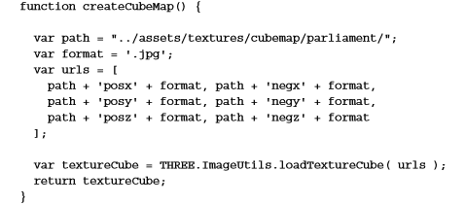
Create a CubeMap object: The first thing we need to do is create a CubeMap object. CubeMap is a set of six textures that can be applied to each side of a cube.
Notes:
Creating CubeMap is pretty easy once you've got the source material. What you need are six images that together make up a complete environment. So you need the following pictures: looking forward (posz), looking backward (negz), looking up (posy), looking down (negy), looking right (posx), and looking left (negx). Three.js will patch these together to create a seamless environment map. There are a couple of sites where you can download these pictures. The ones used in this example are from http://www.humus.name/index.php?page=Textures.

Slide 15
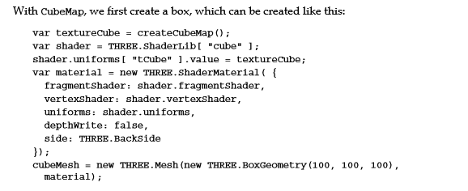
2. Create a box with this CubeMap object: The box with CubeMap is the environment you see when you move the camera around. It gives the illusion that you're standing in an environment where you can look around. In reality, you're inside a cube with textures rendered on the inside to give an illusion of space.

Slide 16
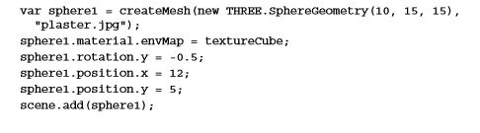
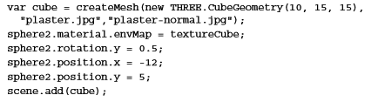
3. Apply the CubeMap object as a texture: The same CubeMap object we used to simulate the environment can be used as a texture on the meshes. Three.js will make sure it looks like a reflection of the environment.

Slide 17
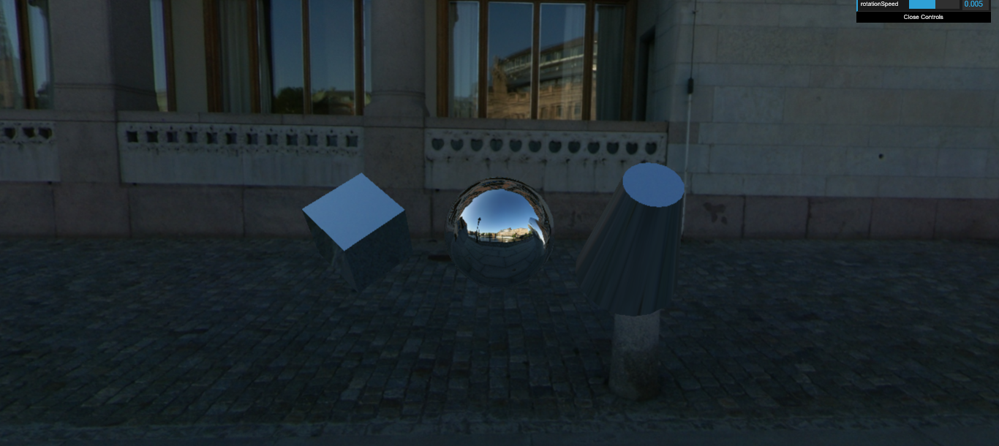
Adding detailed reflection to a material using an environment map (Dynamic)

Slide 18
The first thing we need is an additional camera called THREE.CubeCamera:
We only apply the dynamic reflections to the sphere, so we're going to need two different materials
Notes:
We will use THREE.CubeCamera to take a snapshot of the scene with all the objects rendered, and use that to set up CubeMap. You need to make sure you position this camera at the exact location of THREE.Mesh on which you want to show the dynamic reflections. For this example, we'll only show reflections on the center sphere (as you can see in the previous screenshot). This sphere is located at the position 0, 0, 0, so for this example, we don't need to explicitly position THREE.CubeCamera.

Slide 19
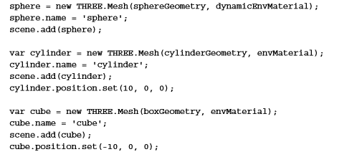
The main difference with our previous example is that for the dynamic reflections, we set the envMap property to cubeCamera.renderTarget instead of to textureCube, which we created earlier. For this example, we use dynamicEnvMaterial on the central sphere and envMaterial for the other two objects:

Slide 20
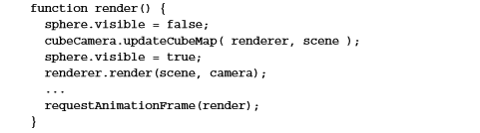
All that is left to do is make sure cubeCamera renders the scene, so we can use that output as input for the center sphere. To do this, we update the render loop like this:
Notes:
As you can see, we first disable the visibility of sphere. We do this because we only want to see reflections from the other two objects. Next, we render the scene using cubeCamera by calling the updateCubeMap function. After that, we make sphere visible again and render the scene as normal. The result is that in the reflection of the sphere, you can see the reflections of the cube and the cylinder.

Slide 21
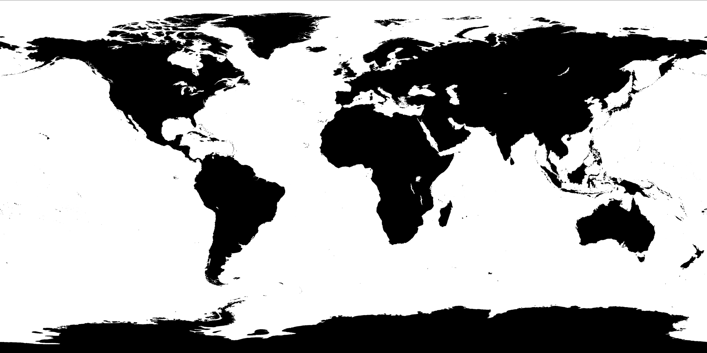
Specular Map
With a specular map, you can specify a map that defines the shininess and the highlight color of a material.
Basically, what happens is that the higher the value of the pixel (from black to white), the shinier the surface will appear.

Slide 22
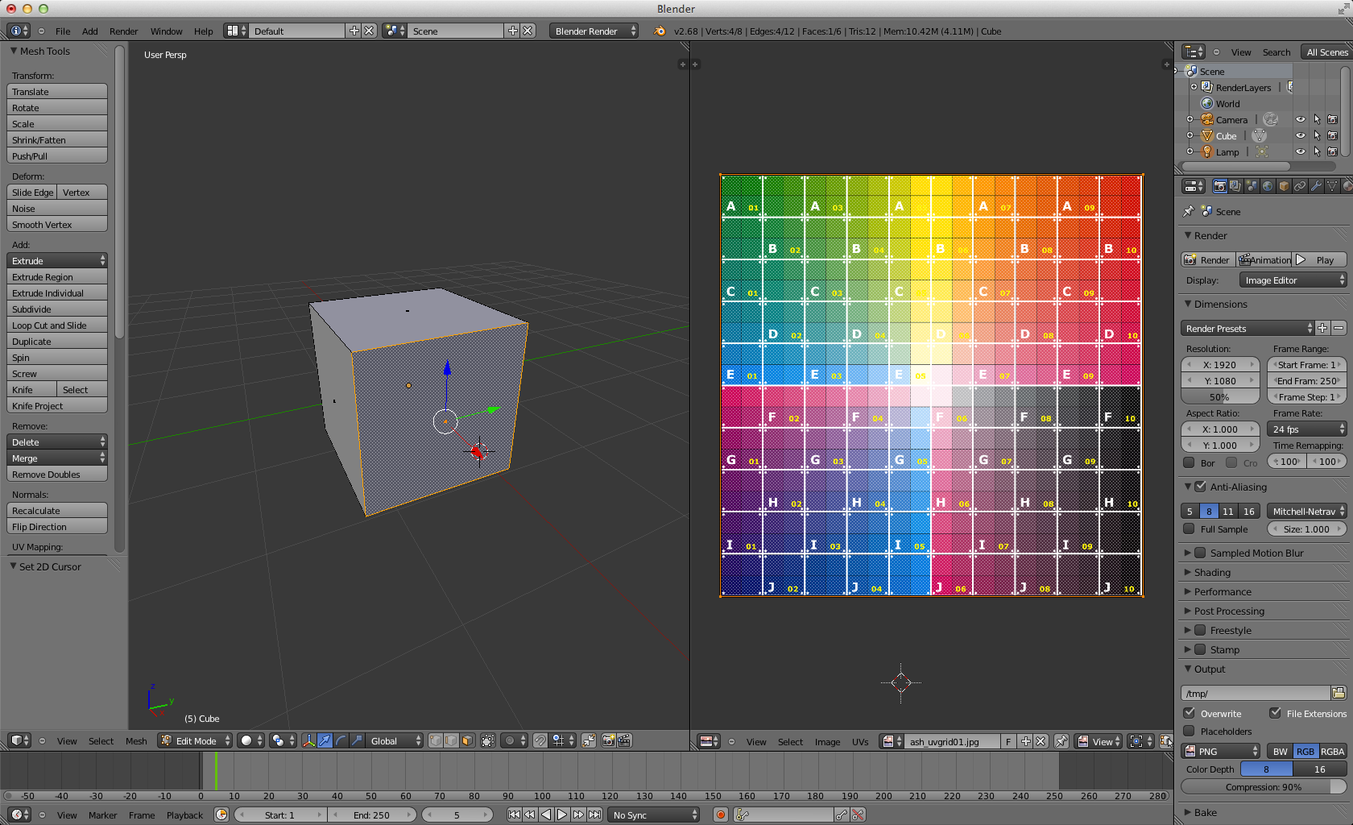
Custom UV Mapping
All faces with complete texture

Slide 23
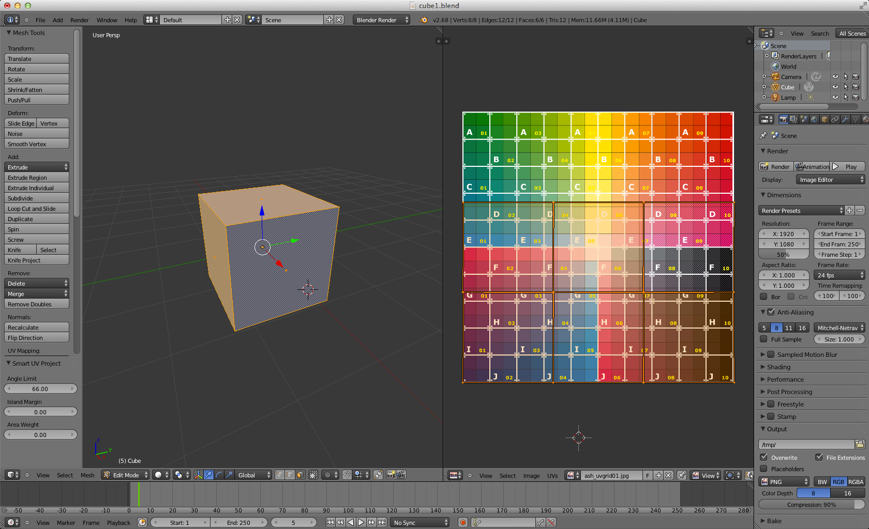
Custom UV Mapping (cont.)
Faces with different UV mappings

Slide 24
Wrapping
THREE.RepeatWrapping allows the texture to repeat itself.
THREE.ClampToEdgeWrapping is a default setting. With THREE.ClampToEdgeWrapping, the texture doesn't repeat as a whole, but only the pixels at the edge are repeated.

Slide 25
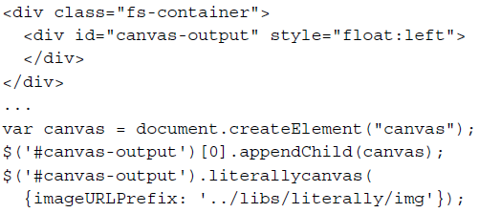
Canvas as a texture
Using Literally library to create interactive canvas
The first thing we need to do is create a canvas element

Slide 26
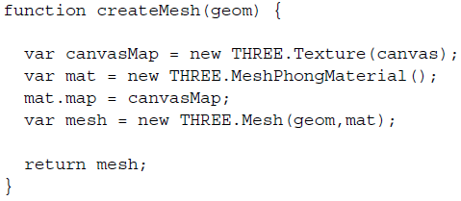
Canvas as a texture (cont.)
Create a texture that uses the canvas drawing as its input

Slide 27
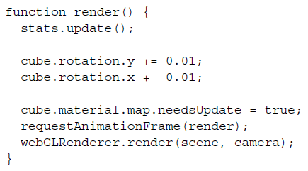
Canvas as a texture (cont.)
Render

Slide 28
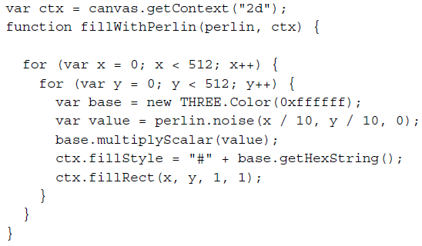
Canvas as a bump map
Use perlin noise to randomly fill the canvas

Slide 29
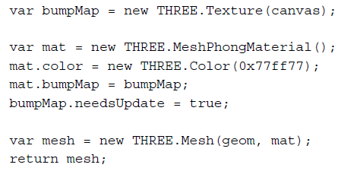
Canvas as a bump map (cont.)
Use the canvas as a bump map

Slide 30
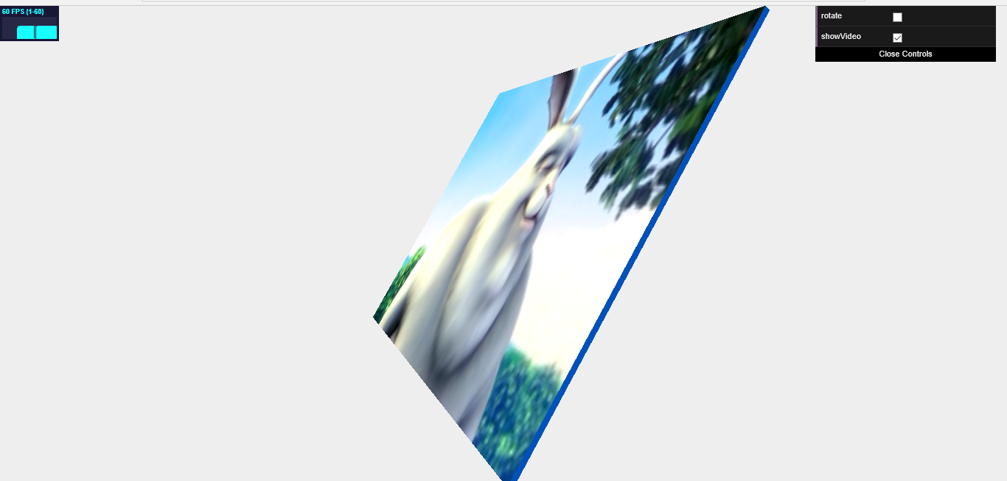
Using the output from a video as a texture

Slide 31
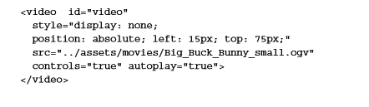
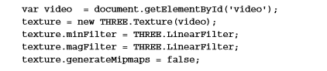
Using video as input for a texture is, just like using the canvas element, very easy. First off, we need to have a video element to play the video:
This was just a basic HTML5 video element that we set to automatically play. Next, we can configure Three.js to use this video as an input for a texture, as follows:

Slide 32
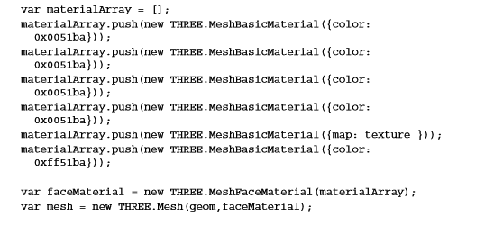
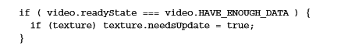
All that is left to do now is create a mesh and set the texture. In this example, we've used MeshFaceMaterial together with MeshBasicMateria
Make sure that in our render loop, we update the texture, as follow:
Notes:
Since our video isn't square, we need to make sure we disable the mipmap generation on the material. We also set some simple high-performance filters as the material changes very often.

Slide 33
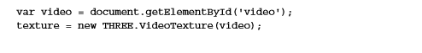
Alternative
In Three.js version r69, a texture specifically for dealing with videos was introduced. This texture (THREE.VideoTexture) wraps the code you've seen in this section, and you can use the THREE.VideoTexture approach as an alternative

